Slide 1
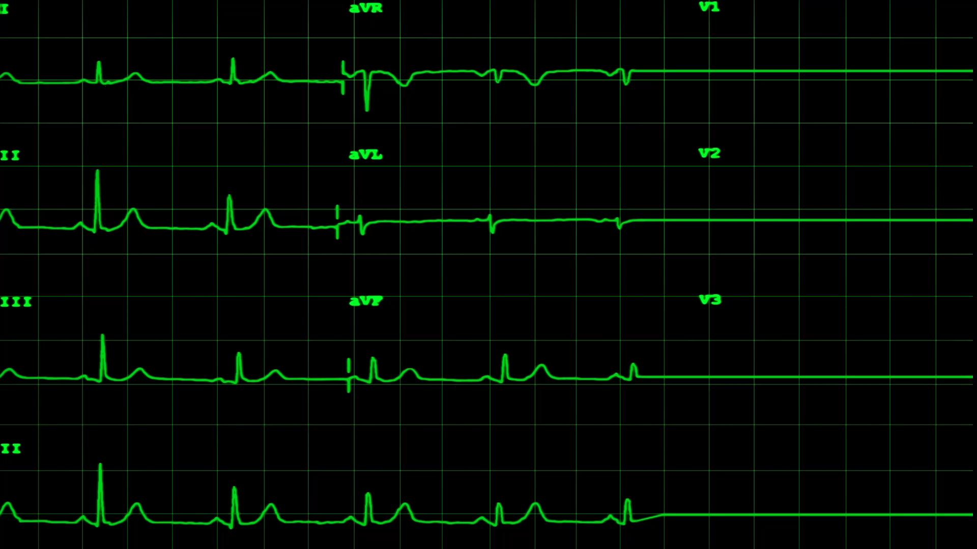

Web Monitoring Tool
Industrial Consulting Project
(COM617)
Aeryk Del Mundo
Afonso Cabeçadas
João Leite
Rui Pinto
Tebogo Dube
Notes:
Hey everyone, this is Rui from group 12 and I will be taking us through the final presentation for our website monitoring project, this project was sponsored by the OpenNMS group with Craig as our supporting tutor, and it was developed by Aeryk, Afonso, João, myself and Tebogo. The link to the project artefact and respective documentation can be found attached to this slide.
Github repo: https://github.com/ruipinto17/IndustrialConsultingProject-COM617

Slide 2
Project Summary
Website Delays
Bad User Experience
Causes
Web Monitoring
Solved by
Notes:
Website delays can be caused by many factors, which can negatively affect the experience of a user and consequently stain the reliability of a company. Companies can prevent these problems by carrying out web monitoring, our team was proposed to develop a solution that monitors the performance and availability of a website.

Slide 3
Objectives
Version | Requirement Text
1.1.1 | Jmeter should be used to create a Test Plan that produces results, this will be the default test plan, which every user will be able to use and adjust with parameters.
1.2.1 | Jmeter test plan results should be sent to Influxdb.
1.3.1 | Should be able to run Jmeter test plan within Java.
1.3.2 | The test plan should be able to continuously create results from the same Test Plan until the program is stopped.
1.3.3 | Parameters should be set in the Jmeter test plan and should be changeable within Java. These parameters should cover: ThreadPool Ramp up time Target URL
1.4.1 | Results will be displayed in Grafana for visualization.
Notes:
The main objective of the project is to develop a synthetic transaction monitoring system that detects slowdowns in a website load time. Our project would execute a JMeter test plan, store performance results and display them to the user, on top of this, the project would be hosted and accessible through the web and the user would be able to edit fields of the test plan or add its own.

Slide 4
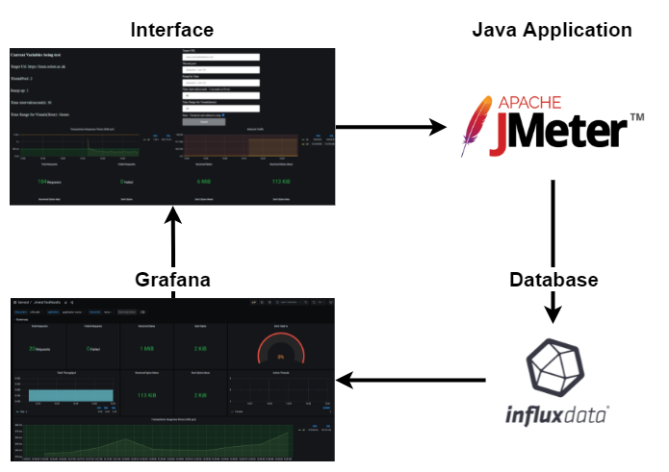
Requirements
Notes:
The main requirements of the project involve storing the results of a JMeter test plan in an influx database and displaying these results graphically to the user. Having JMeter, InfluxDB and Grafana running in individual containers and hosting the platform so it is accessible through the web, further requirements include allowing the user to edit or add a test plan, validate users input and having users create accounts before accessing the system.

Slide 5
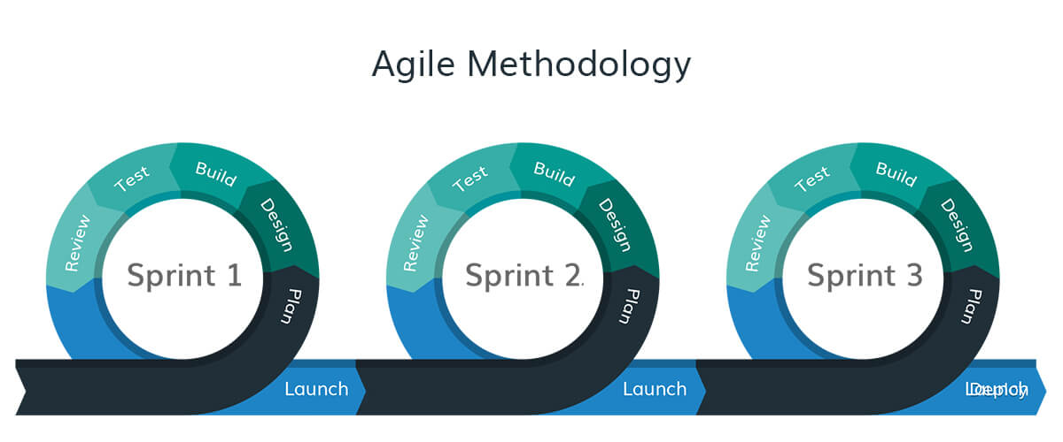
Notes:
The development of this project followed an Agile approach throughout the 3 sprints, following key concepts such as: working over documentation, committing small working bits and adapting to change, this allowed us to dynamically organise and distribute the work, while being prepared to consider any unforeseen change every week.

Slide 6
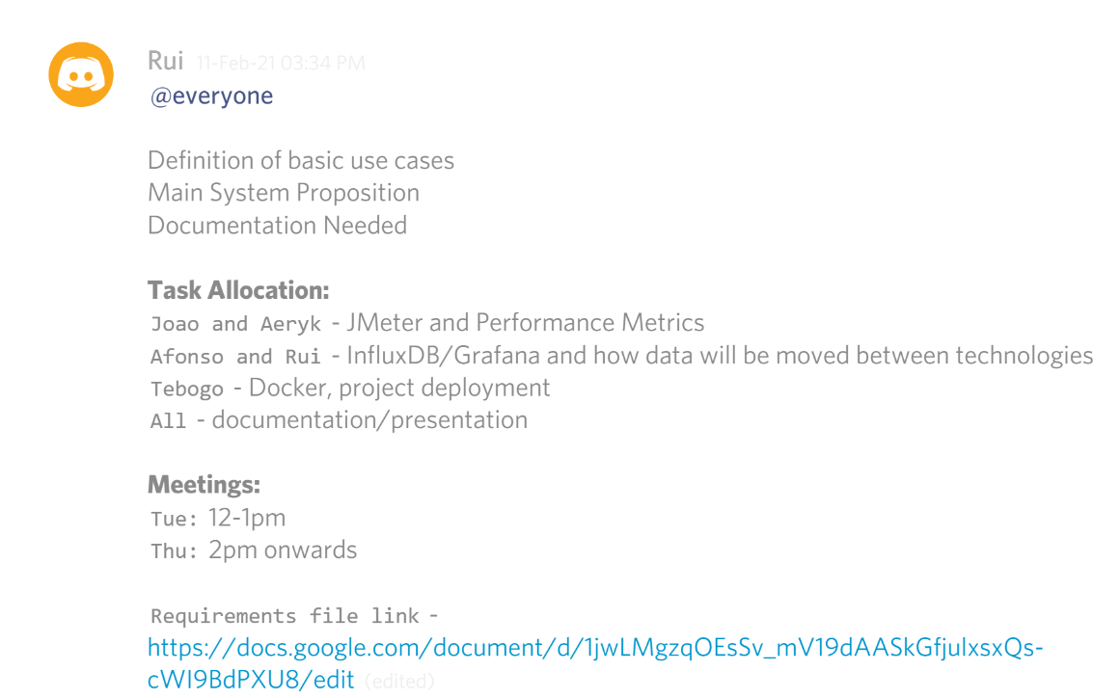
Weekly Sprints/Task Allocation
Notes:
Every week the team would gather and collaboratively think about the tasks to be accomplished throughout the week, these would be allocated considering individual skill and personal motivation, these would also be ranked and higher importance tasks would be prioritised. Unexpected shortcomings from meetings with the supervisor would be fitted into the current week.

Slide 7
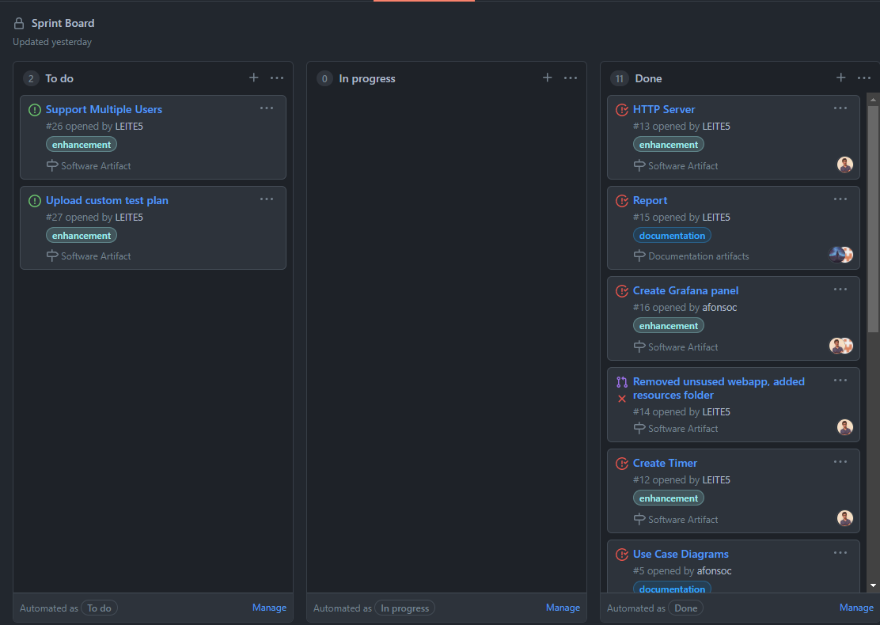
Sprint
Board
Notes:
Weekly tasks were stored and organised on a Github Projects kanban board, this board aimed to overview the completion status (tbc, in progress, done) of all tasks. These were represented by cards that are linked to pull requests, which allowed us to see the history of commits. Cards also held various information such as the author, milestone and category of a task.

Slide 8

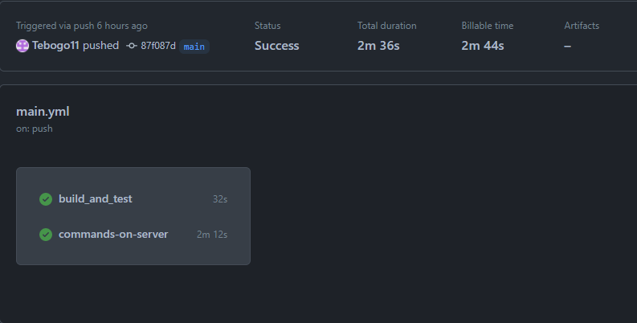
GitHub Actions
Notes:
The actions script implemented aimed to automate the packaging and deployment of the application. The first job builds the application by executing a maven command, and the second one starts all the components, spinning up the project by executing the necessary ssh commands on the server through the script.

Slide 9
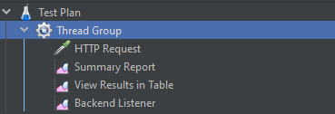
Test Plan Metrics
Notes:
The metrics used in our project derived from the main metrics used in other monitoring tools and include records start time, response status, time to load, latency, wait time and request size. These metrics were collaboratively decided as we came to the conclusion they would be the most useful to graphically represent to the user.

Slide 10
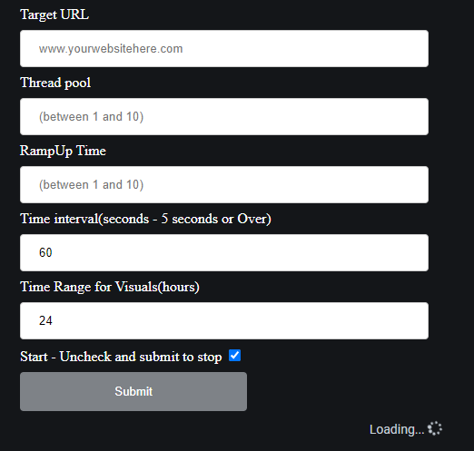
Test Plan Customisation
Notes:
Through a form in our interface that communicates with our main application, users can edit the target website as well as the amount of threads, simulated users, ramp up time and the time between tests. This allows the performance of different types of tests (stress, performance). Further implementations to test plan customisation would include more editable settings.

Slide 11
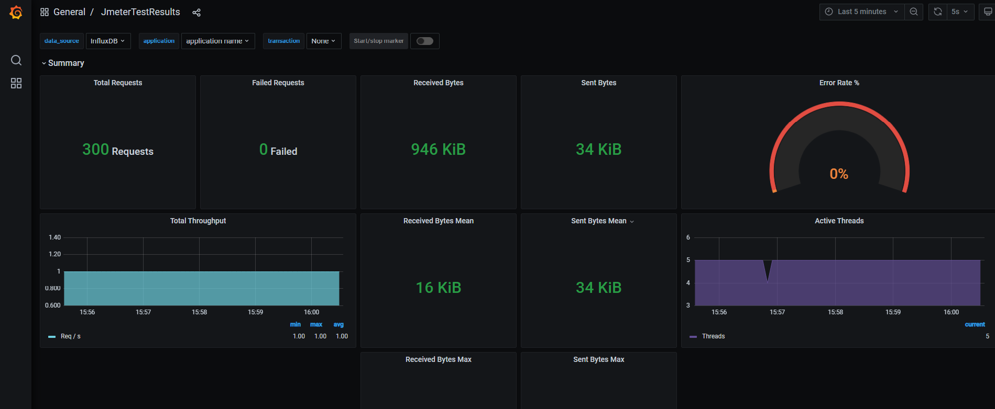
Grafana Dashboard
Notes:
The grafana dashboard aims to visually represent test results to the user, these include the transaction response time, error rate, total number of requests and more. The dashboard contains a combination of graphs that were agreed to be suitable to understand the results based on their statistical or time-series nature.

Slide 12
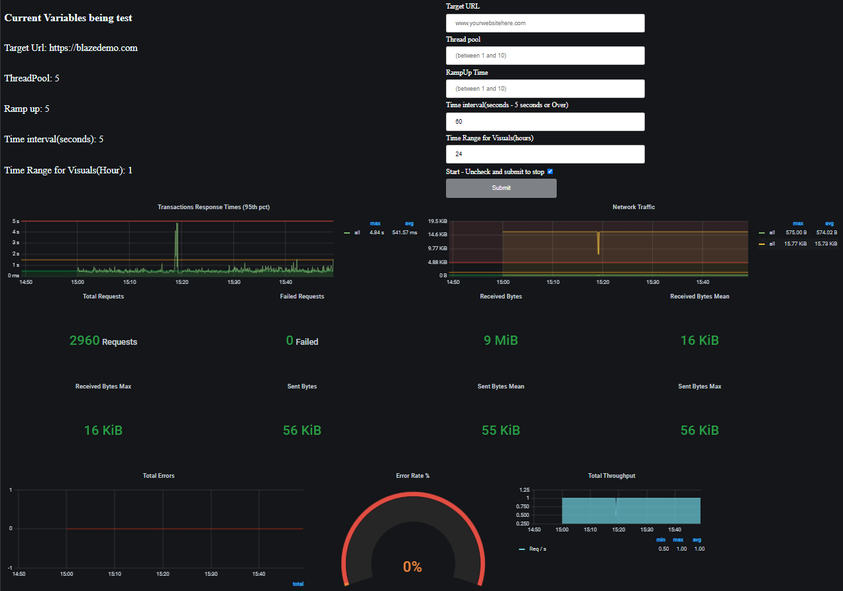
Real Time Visualization
Notes:
The grafana dashboard is embedded onto the web application of the project, and it serves as the user interface. The webpage displays the settings of the currently running test, and when the configurations are edited the results are updated in real time, which allows the user to assess the performance of the targeted platform.

Slide 13
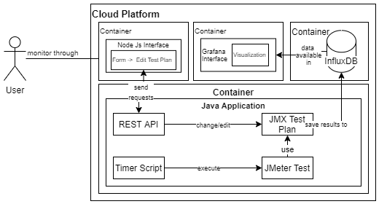
Flow of Information Through All The Components
Notes:
The project starts by displaying the user interface. When a user submits the form, the values are sent to our HTTP server that will restart the test plan with the new settings. The results will then be saved to influxDB, and displayed to the user through embedded grafana panels in the form of graphs.

Slide 14
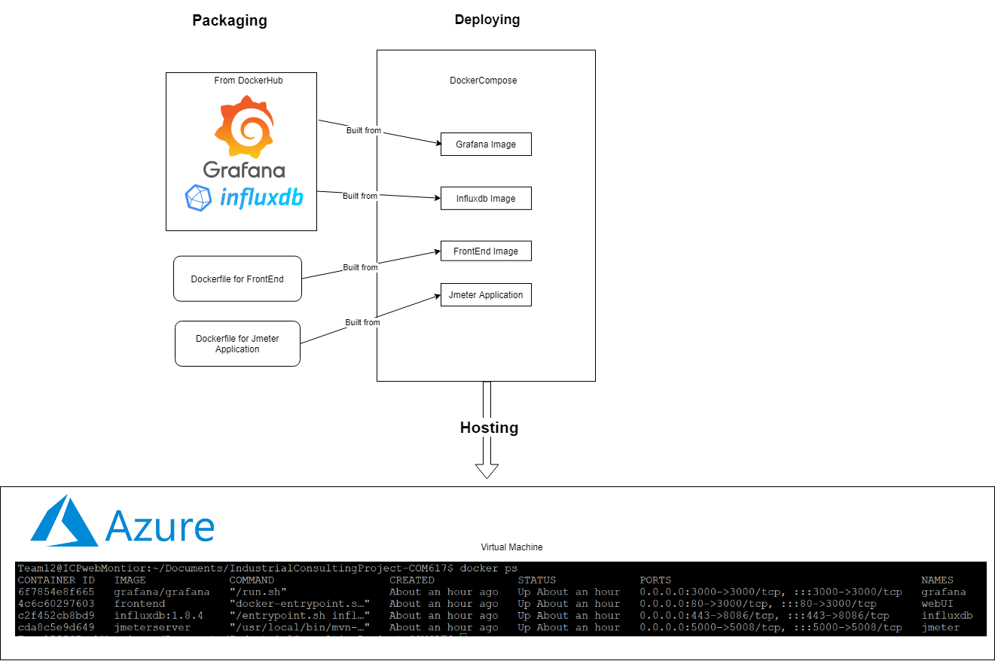
Packaging/Deploying/Hosting Considerations
Notes:
All three major components are running in different Docker containers and are being booted up with a docker compose file, the service is being hosted on a virtual machine in Azure and is accessible through the web. The second job of the actions script mentioned above deploys the application after committing any code to the repo.

Slide 15
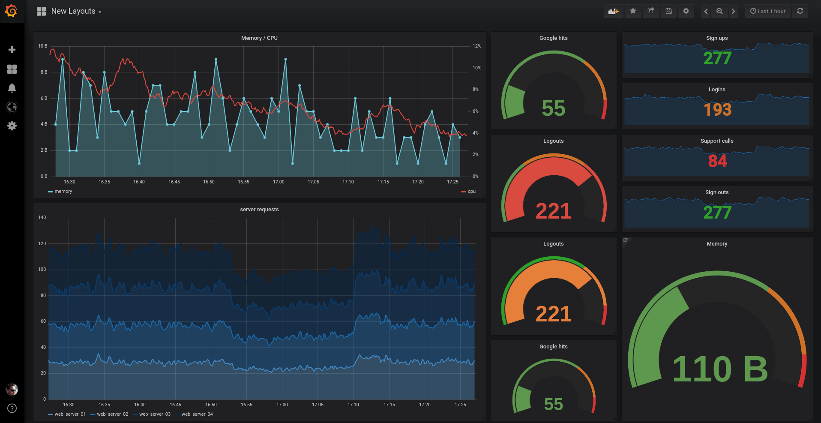
User Interface Appraisal
Notes:
The Initial idea was to use the Grafana dashboard as the main interface and create a custom form plugin that would communicate with our application. However, this proved to be time consuming so we decided to embed the dashboard in a separate web app. The user interface design aims for simplicity, but further implementations could include more complex graphs.

Slide 16
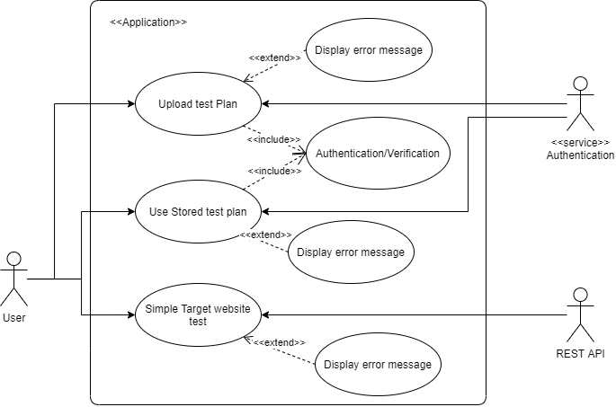
Use Case Success Rate
Notes:
The project agreed on a scope that covered two use cases:
Use a default test plan with custom settings to perform web monitoring
Having the option for the user to upload a test plan
The first use case was achieved, and implementing the second one, would open the opportunity for more experienced users to develop their own test plans, which would generate more tailored monitoring data.

Slide 17
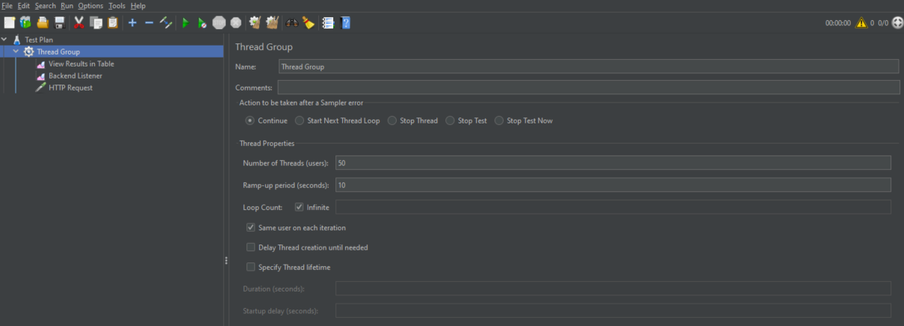
JMeter Test Demo
Notes:
Thread groups can have multiple tests and support other features like cookies, these can also be used programmatically to customize the test plan, results can be filtered, processed and shown in visualisation within JMeter or exported to supported databases and file formats.

Slide 18
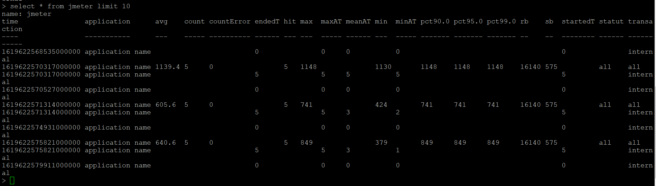
InfluxDB Component Demo
Notes:
Influxdb was used to store the results of the test plans, it was appropriate since it was developed to handle large volumes of time-series data. In order to accomodate more users, we would store test results in individual data nodes which would be associated with the respective users.

Slide 19
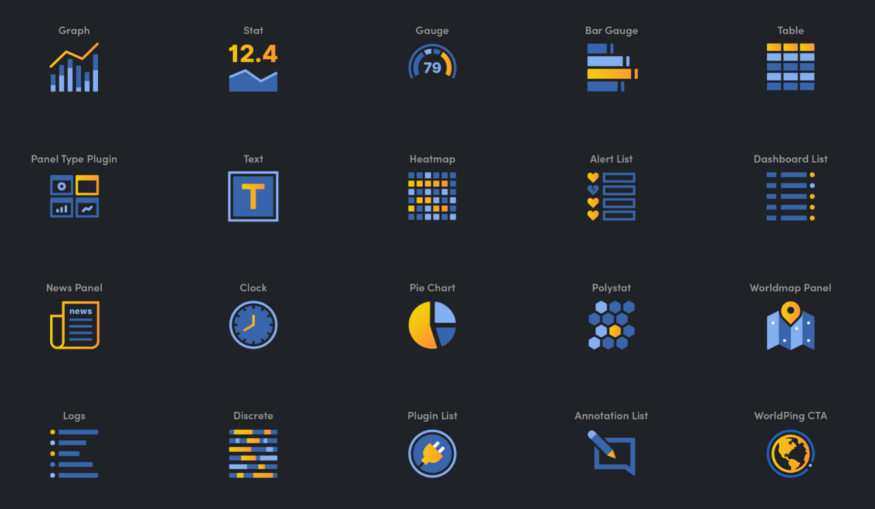
Grafana Component Demo
Grafana Component Demo
Notes:
Grafana provides the graphs that are used in our interface, further implementations would include, expanding the existing visualisations, and creating custom plugins which would have allowed to use it as the main interface. It also offers the possibility to support multiple users with user authentication features.

Slide 20
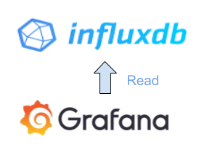

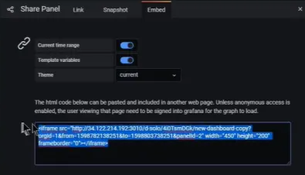

Whole Flow Demo
Notes:
Our User Interface built with Nodejs, passes the data inserted by the user to our java application, which processes the variables into a new Test Plan task. The test plan uses a backend listener connected to our influx database. Grafana takes the information stored in influxdb and displays it in panels which are sent back to the User Interface using iFrames.

